Slide 1
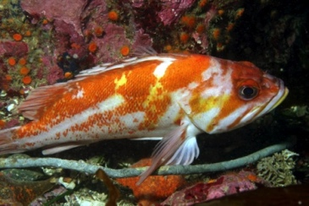
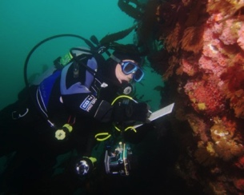
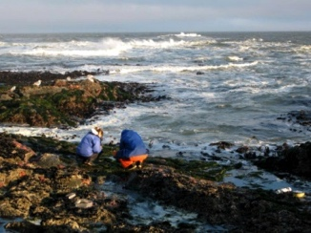
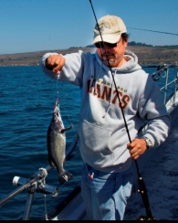
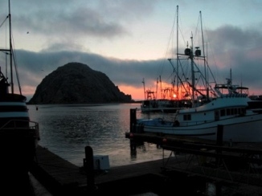
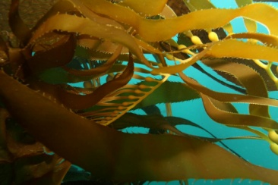
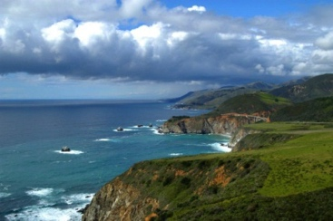
California’s Statewide MPA
Monitoring Program
Stephen Wertz
Supervisor, Statewide MPA Management
California Department of Fish & Wildlife
Erin Meyer, Ph.D.
Program Manager, MPA Monitoring
California Ocean Science Trust

Slide 2
California Department of Fish & Wildlife
Role = Management Lead
Program Manager (1)
MPA Statewide Management
MPA Education and Outreach
Supervisor (1)
Fulltime MPA management (2)
Scientific collecting permits (2)
ROV data collection (1)
MPA GIS (1)
Supervisor (1)
Fulltime MPA education and outreach (4)
Notes:
STEVE

Slide 3
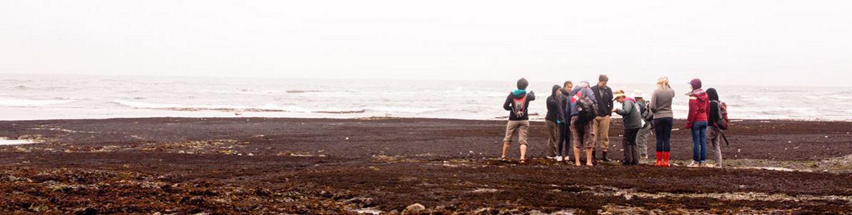
California Ocean Science Trust
Role = Science Lead
Working across boundaries | Building trust & understanding in science
LINKED TO THE STATE
We’re an independent non-profit, created through legislation.
MAKING SCIENCE USEFUL
We empower broad participation in management with useful science and knowledge.
PARTNERS IN GOOD GOVERNANCE
We’re independent of academia and the state, but linked to both.

Slide 4
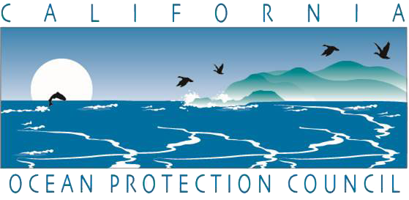
California Ocean Protection Council
Role = Policy Lead
Improve communication and collaboration
Support agencies in meeting their mandates
Work with partners to identify, develop and implement policies
Notes:
STEVE

Slide 5
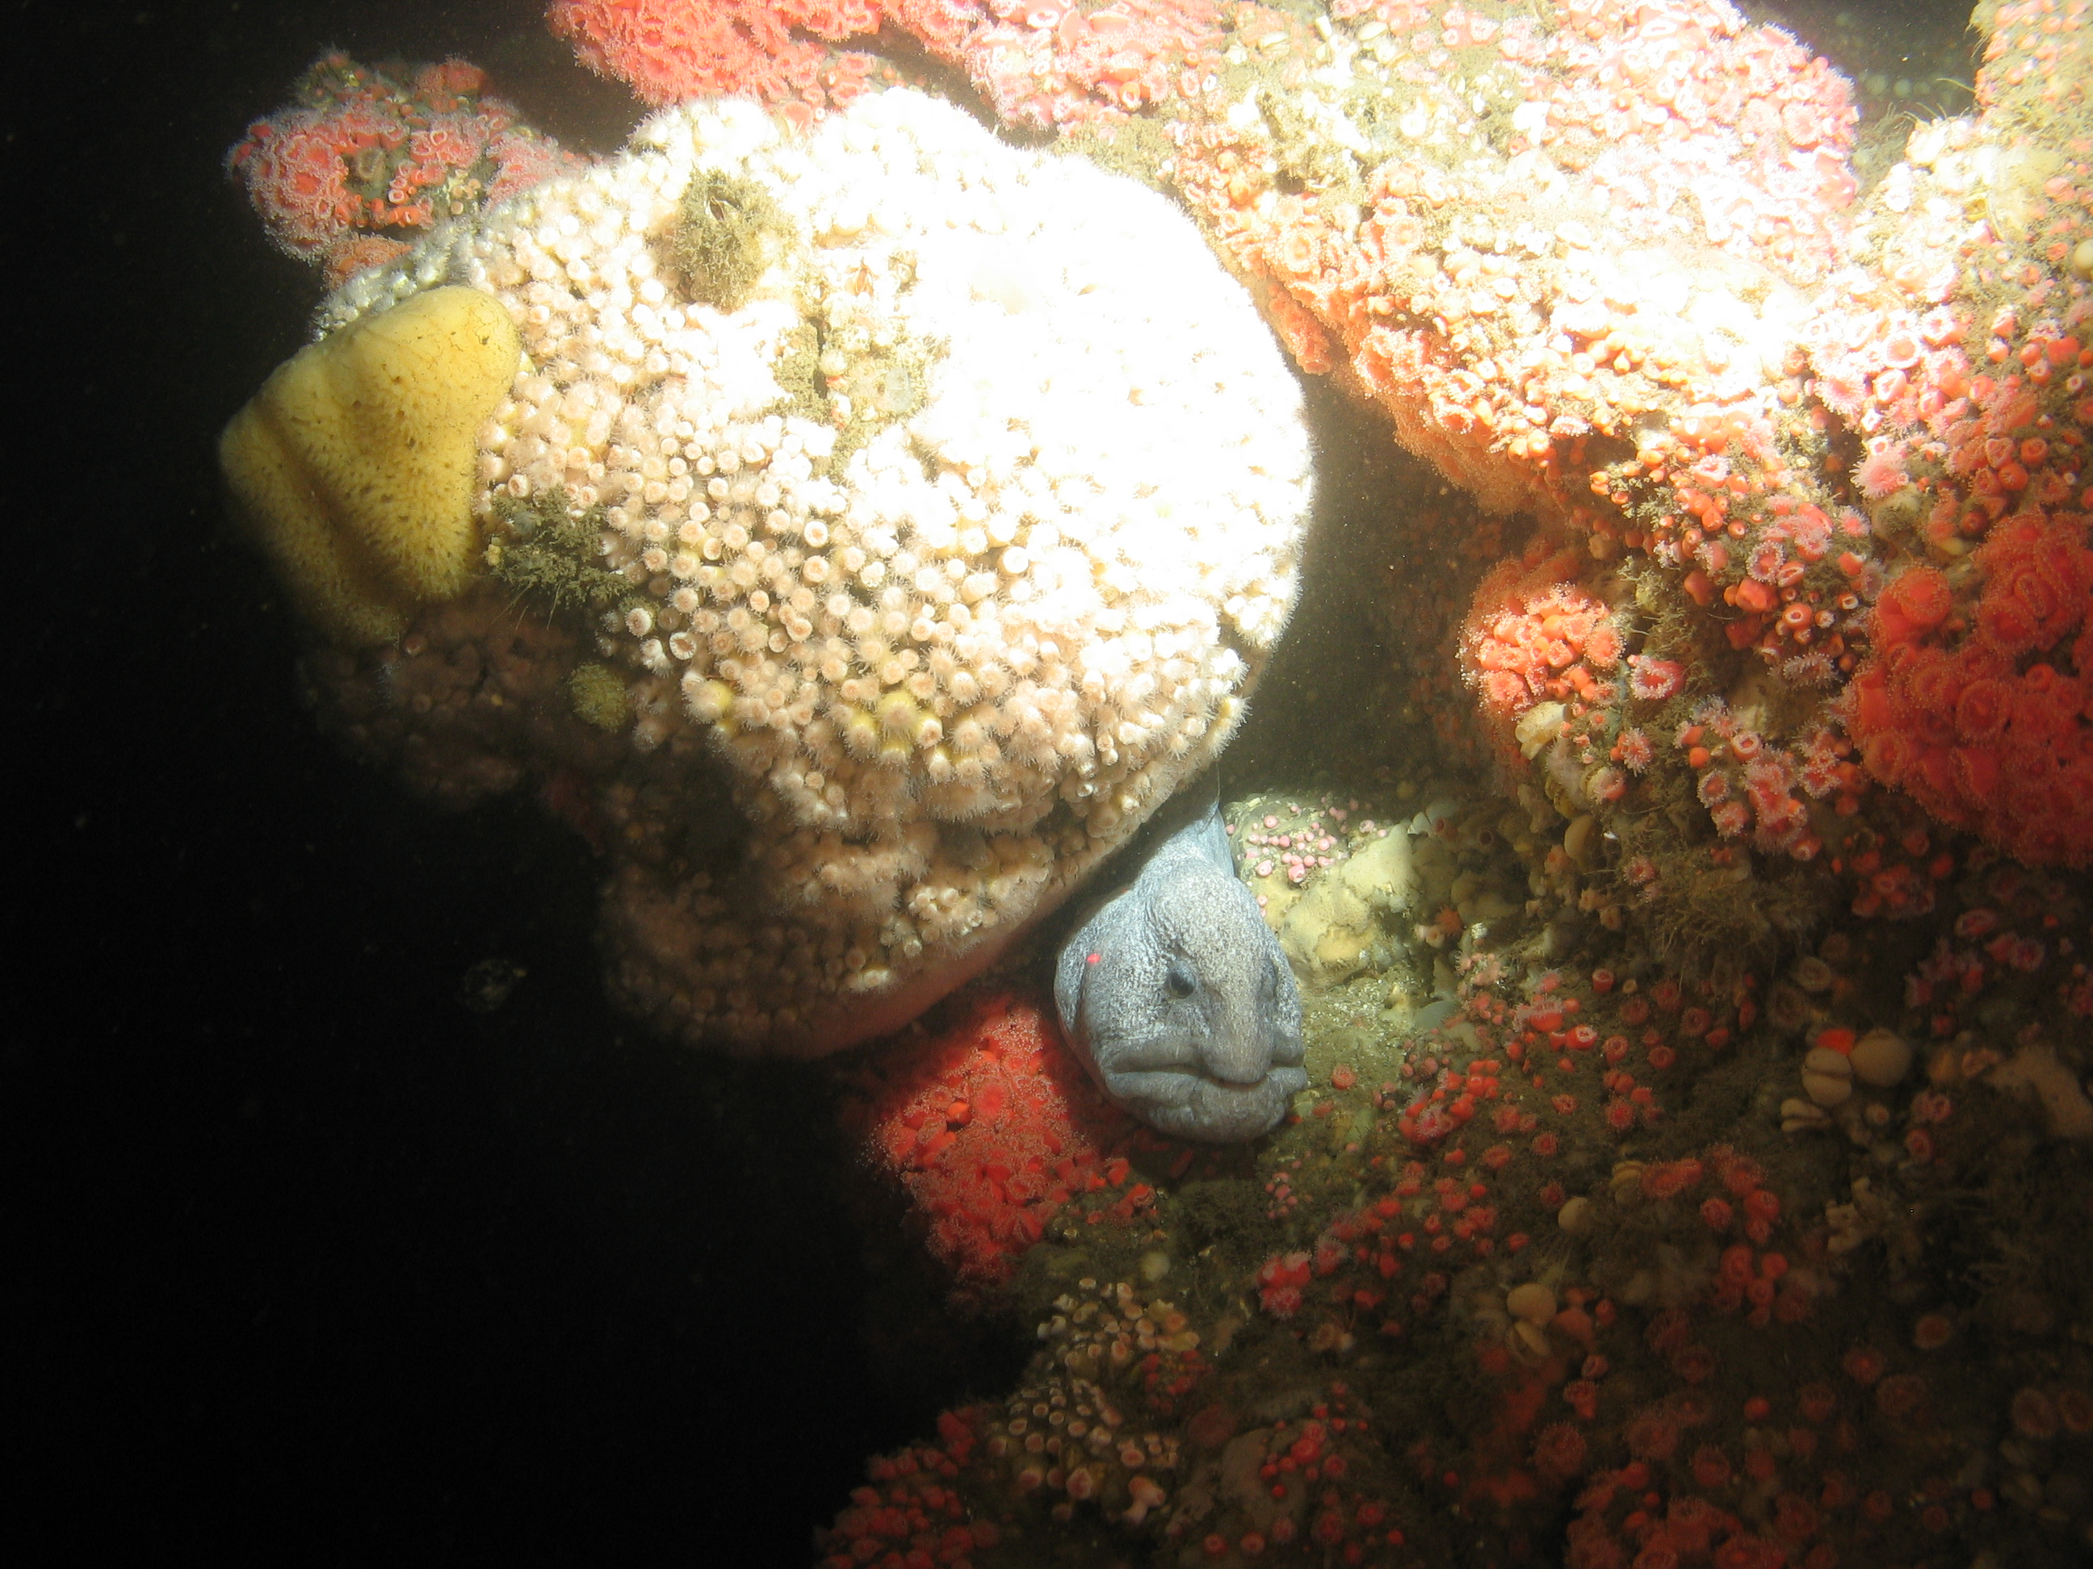
Marine Life Protection Act
Signed into California State Law in 1999
Redesign existing MPAs to meet six specific goals
Focuses on biodiversity, habitats, and ecosystems
Requires monitoring and evaluation
Managed as a network
Adaptive management
Notes:
STEVE

Slide 6
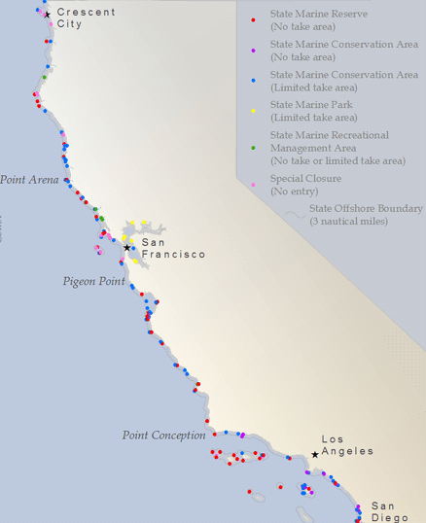
Redesigned Coastwide MPA Network
Marine Life Protection Act called for change
Participatory process completed in 2012
Largest scientifically designed network of MPAs
124 MPAs & 15 special closures
16% of state waters
9% in no-take reserves

Slide 7
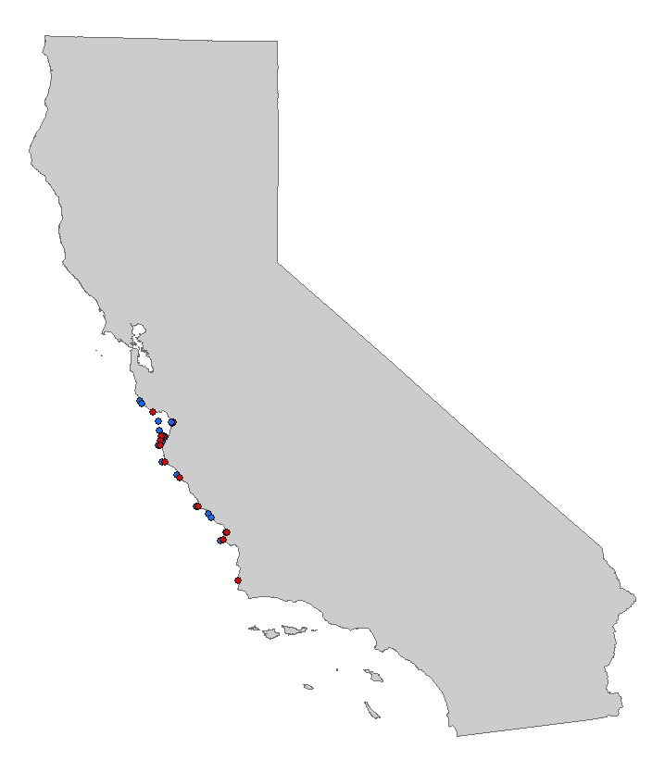


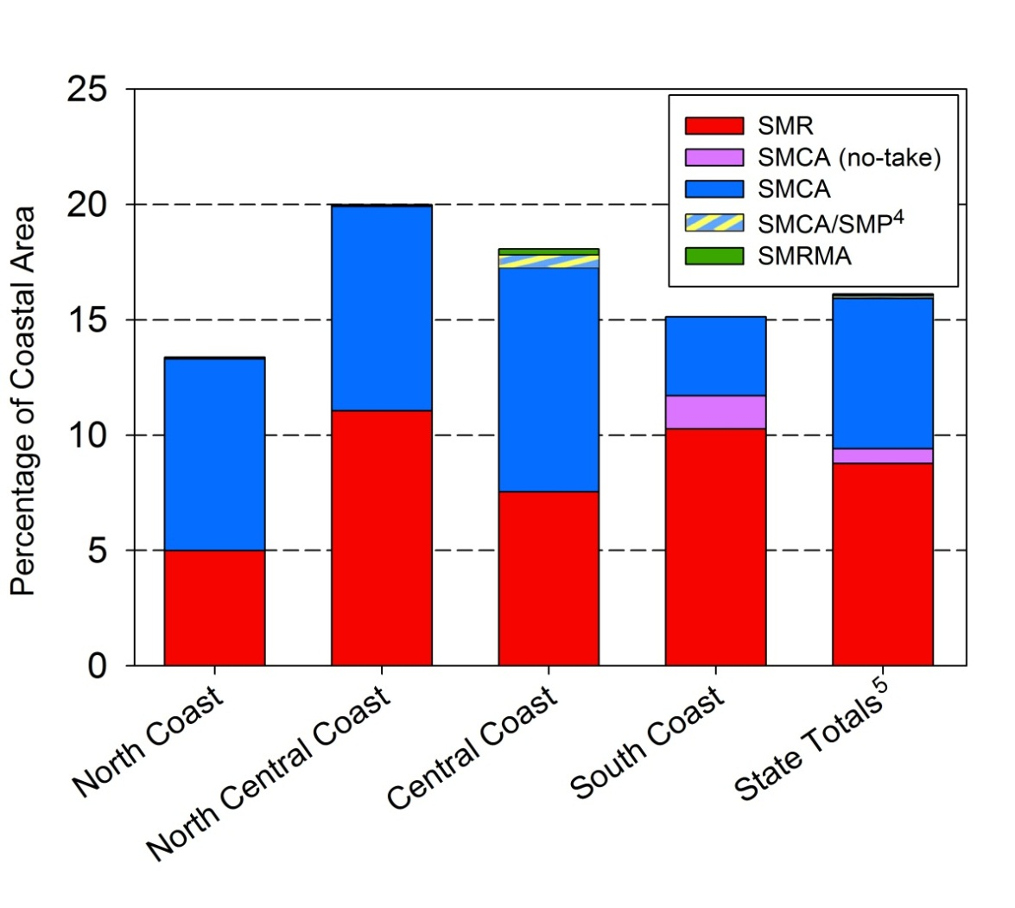

Redesigned Coastwide MPA Network
North Coast (20)
(2012)
MPA Coverage
North Central Coast (25)
(2010)
Central Coast (29)
(2007)
South Coast (50)
(2012)
Notes:
STEVE

Slide 8
Phase 1: Baseline Monitoring
Phase 2: Long-term Monitoring
Research &
Monitoring
Enforcement & Compliance
MPA
Management Program
Outreach & Education
Policy &
Permitting
Notes:
STEVE
Now I will drill down a little more on the Monitoring & Research focal area:
To facilitate the adaptive management of California’s MPAs, CDFW and partners provide oversight and support to lead all aspects of MPA monitoring, research, and evaluation.
Scientific monitoring is essential for collecting information that can be used to assess the conditions and trends of marine populations, habitats, and ecosystems, evaluate MPA design and efficacy, and make informed management decisions.
California has established a two-phased approach to monitoring California’s MPAs:
Baseline Monitoring, and
Long-term Monitoring

Slide 9
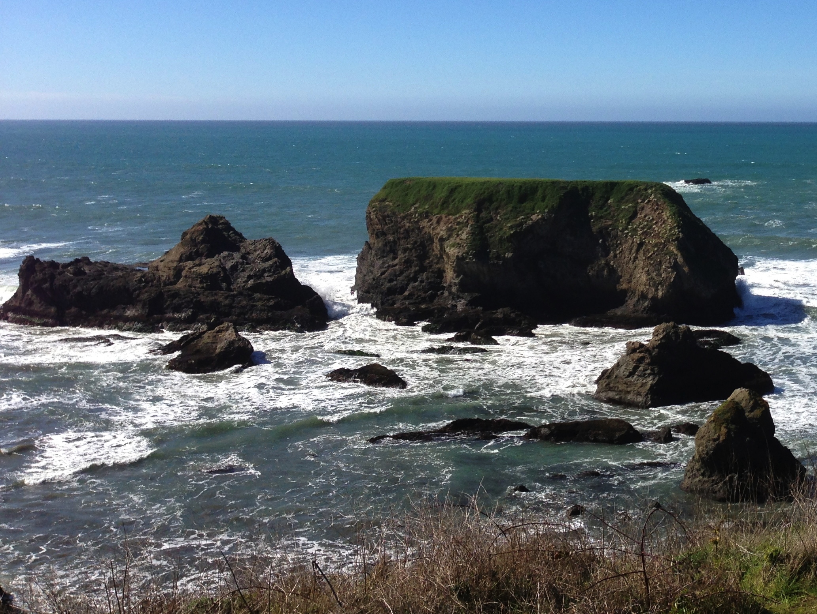
Research & Monitoring: Statewide MPA Monitoring Program Provide useful information to inform decisions

Slide 10
What is monitoring?
What information do we need?
Start with community priorities and management needs
Collect a suite of key ecological and socioeconomic data
Who should collect that information?
Scientists, citizen scientists, local communities
Who should have access to and use the results?
Policy makers, managers, and the public

Slide 11
What are the Goals of MPA Monitoring?
What are the goals of MPA monitoring?
Inform evaluation of the MPA network at meeting MLPA goals.
Mobilize & engage a wide array of community members, experts, & scientists.
Seed partnerships that build durable capacity, cost-effective projects, and broad support for MPA monitoring.
Demonstrate the value of monitoring data for multiple state priorities (e.g., sustainable fisheries, climate change, and water quality).
Provide credible, useful science that is accessible to everyone, & will inform decision-making.

Slide 12
MPA MONITORING FRAMEWORK
ECOSYSTEM FEATURES
Examples: Kelp & Shallow Rock Ecosystems, Rocky Intertidal Ecosystems
ASSESSING ECOSYSTEM
CONDITION & TRENDS
How is the system doing?
EVALUATING MPA DESIGN &
MANAGEMENT DECISIONS
How are MPAs affecting the system?
ECOSYSTEM FEATURE CHECKUP
SHORT-TERM EVALUATION QUESTIONS
Answerable within 5 years
Vital Signs
Examples:
Are there impacts (e.g., trampling) of increased visitation on rocky intertidal ecosystems in MPAs?
What are the ecological & fisheries effects of placing an MPA boundary across a reef versus around a reef?
Designed for implementation by community and citizen-scientist groups
Designed for implementation by government agencies and research institutions
AND/OR
AND
LONG-TERM EVALUATION QUESTIONS
More than 5 years to answer
Examples:
Are there differences in ecosystem responses (types & rates of changes) between SMR/SMCA clusters and stand-alone SMRs?
What are the population effects of siting MPAs in larval source or sink locations, and what are the implications for MPA network design?
Key Attributes &
Indicators
ECOSYSTEM FEATURE ASSESSMENT
Notes:
ERIN

Slide 13
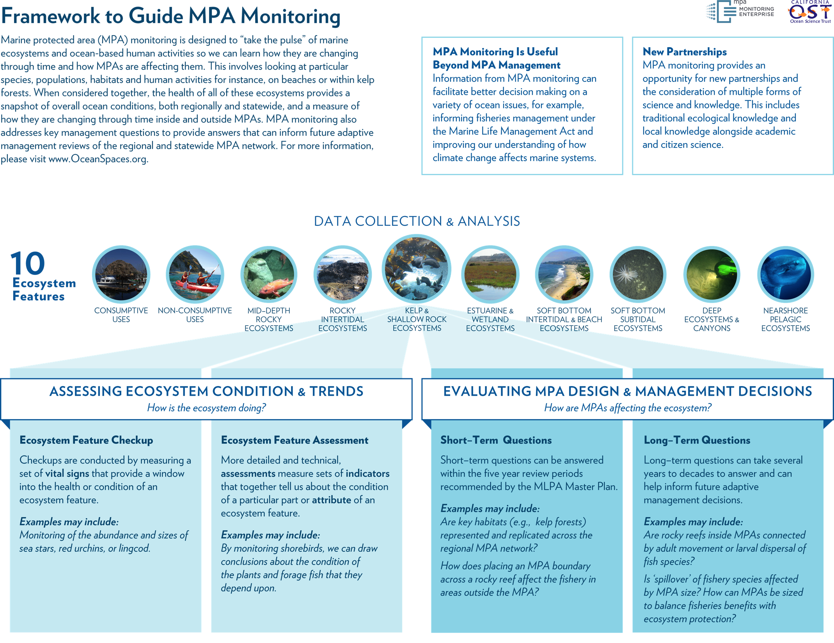
Notes:
ERIN

Slide 14
Assessing change & MPA performance
Statewide MPA Monitoring Framework
Statewide Action Plan
(underway)
Regional
MPA Monitoring Plans
MPA Monitoring
Baseline Monitoring
Sharing Results
Management Review
Long-term Monitoring

Slide 15
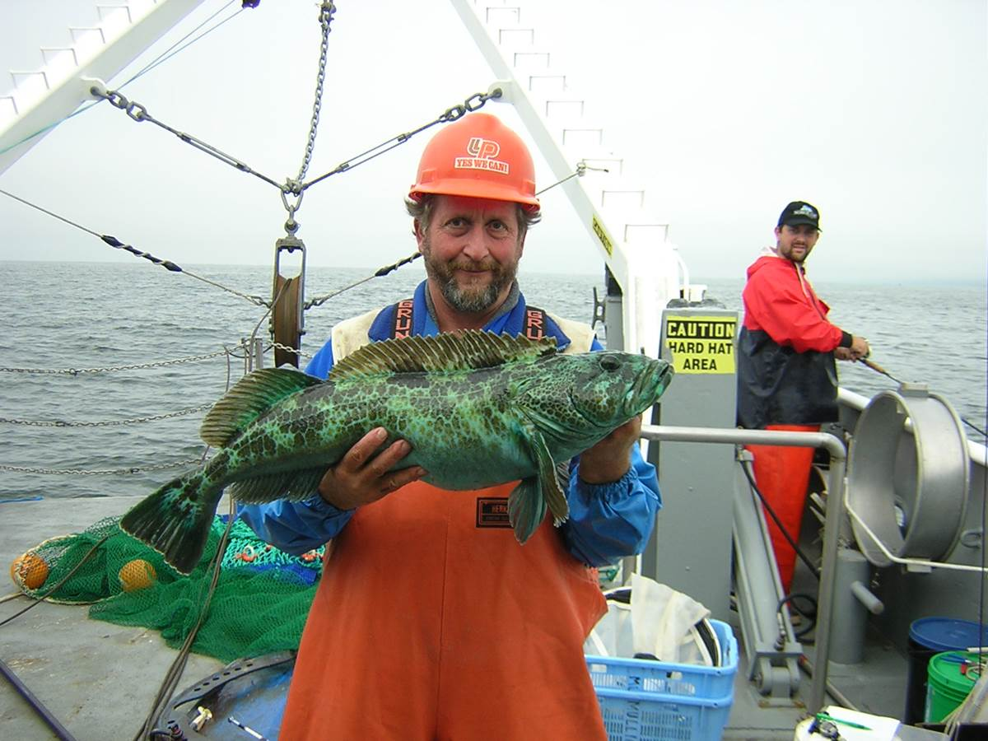

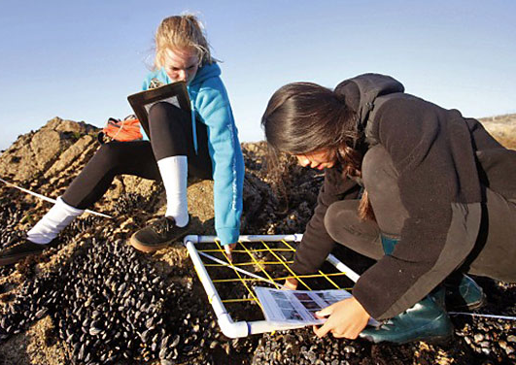
A partnerships-based approach to monitoring
Leverages existing monitoring capacity
Broadens participation in monitoring
Incorporates different knowledge types

Slide 16
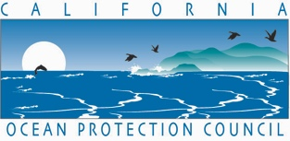



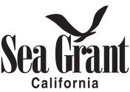

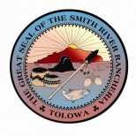






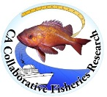
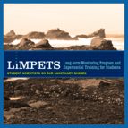
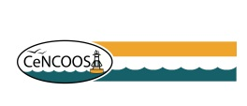











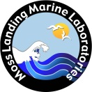

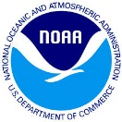
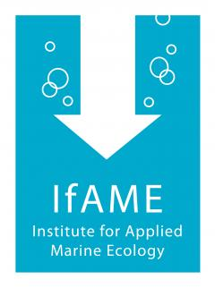













Building a network of people
$19 million invested by OPC (Prop 84)
$2.5 million annual General Fund appropriation
Notes:
ERIN

Slide 17
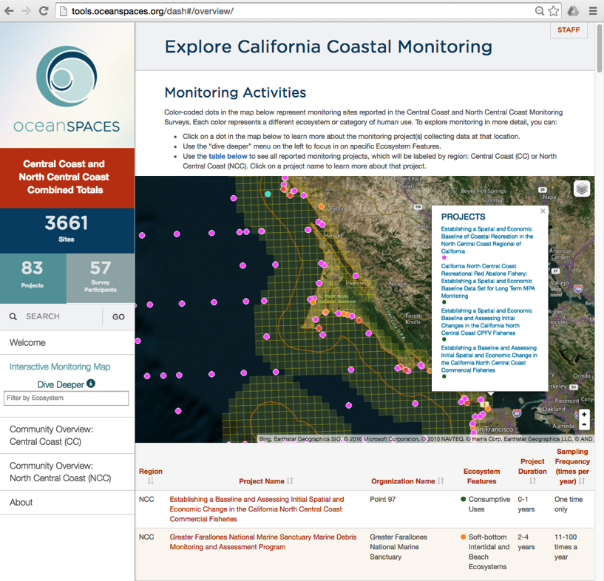
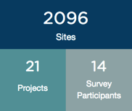
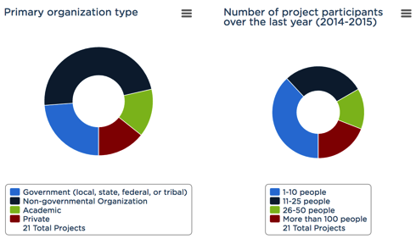
Expanding the community
Monitoring survey & interactive dashboard connect local capacity
http://tools.oceanspaces.org/dash#/welcome/
Notes:
ERIN

Slide 18
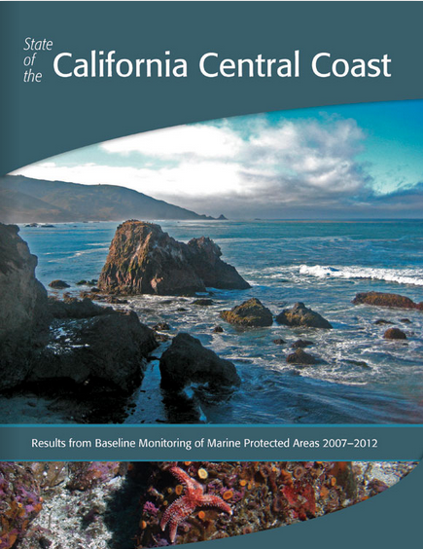
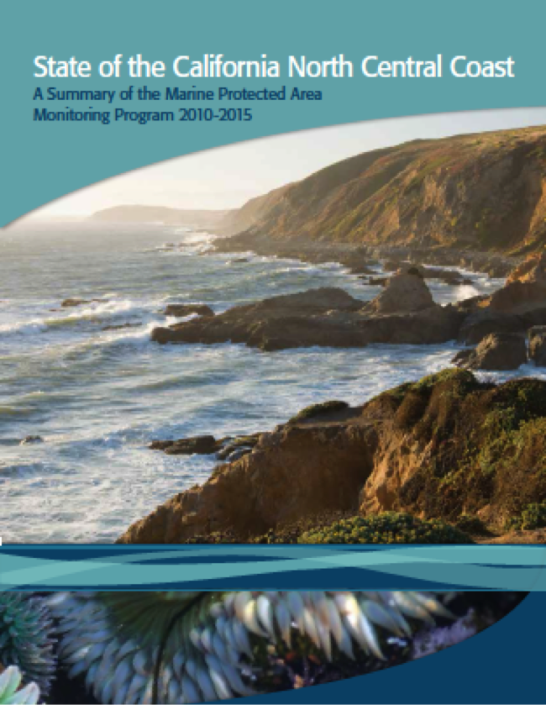
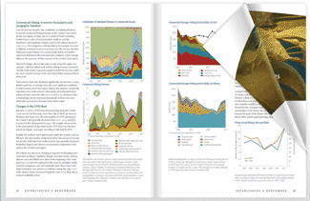
Notes:
ERIN

Slide 19
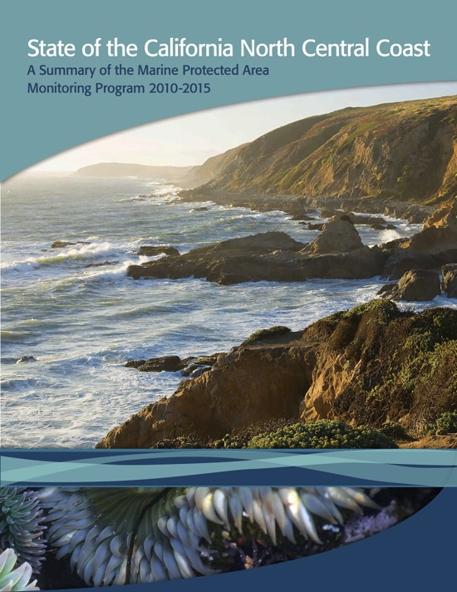
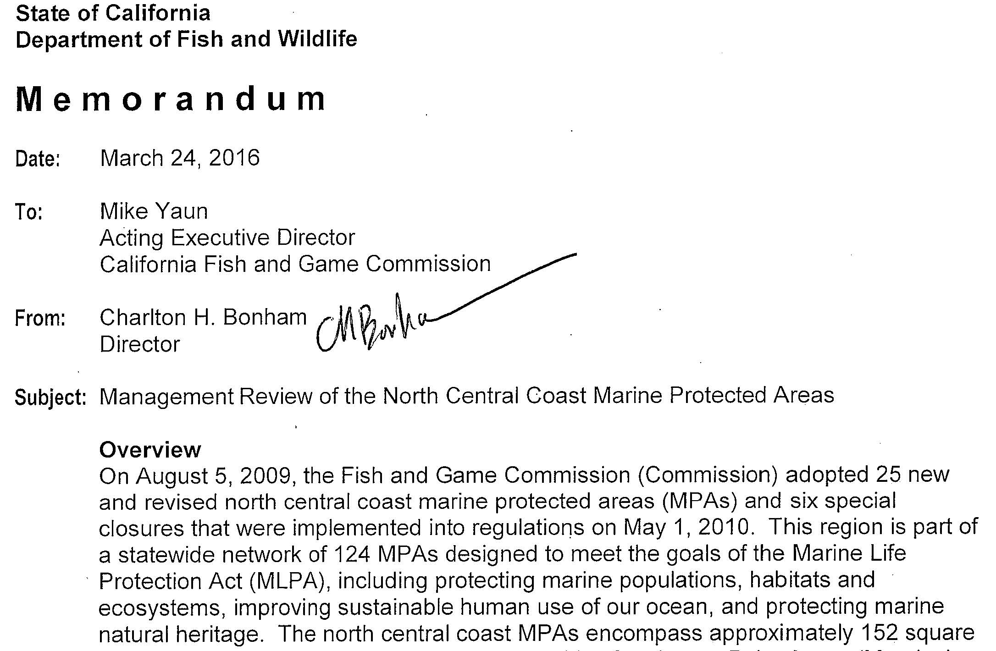
Informing MPA Management
Identify goals
& objectives
MPA design &
planning
Implement
MPA network
MPA monitoring
planning
Inform
Adaptive
Management
Implement
MPA monitoring
Collect &
analyze data
Baseline programs
Report
monitoring
results
Communicate
results
Notes:
STEVE

Slide 20
Status of Regional Baseline Monitoring
Central Coast | 2007 | 2007-2012 | 2012-2013 | 2013
North Central Coast | 2010 | 2010-2014 | 2014-2015 | 2016
South Coast | 2011 | 2011-2015 | 2016-2017 | 2017
North Coast | 2013 | 2014-2017 | 2017-2018 | 2018
Review & Select
Projects
Collect & Analyze
Data
Synthesize &
Share Results
5-year
Management
Review
= completed
= underway
= year complete
Notes:
ERIN

Slide 21
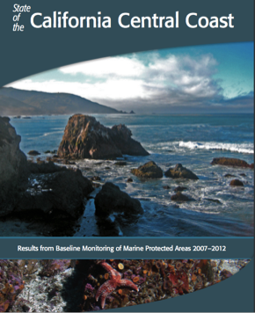
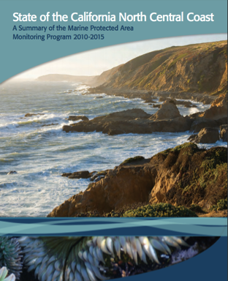
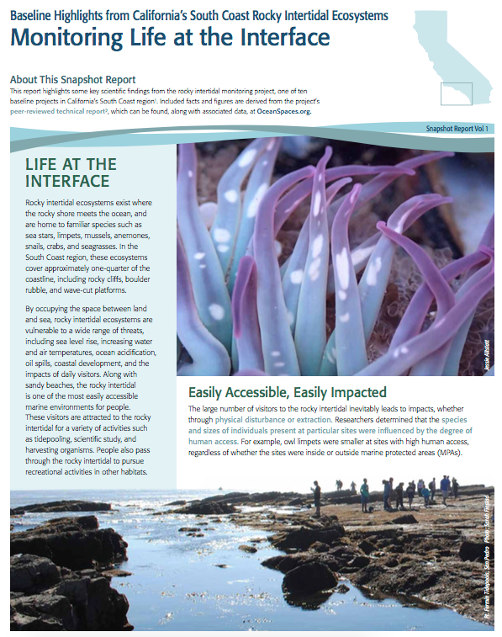

Explore baseline monitoring data & results
Notes:
ERIN

Slide 22
Statewide Long-term Monitoring
Initial Spending (2016)
Launch data collection in priority ecosystems.
Maintain capacity of CDFW to collect data through equipment upgrades.
Expand science-management collaborations through post-doctoral positions co-mentored by UC Davis and CDFW.
Support Ocean Science Trust to help the state develop monitoring that serves across agencies and mandates.
Statewide MPA Action Plan (2018)

Slide 23
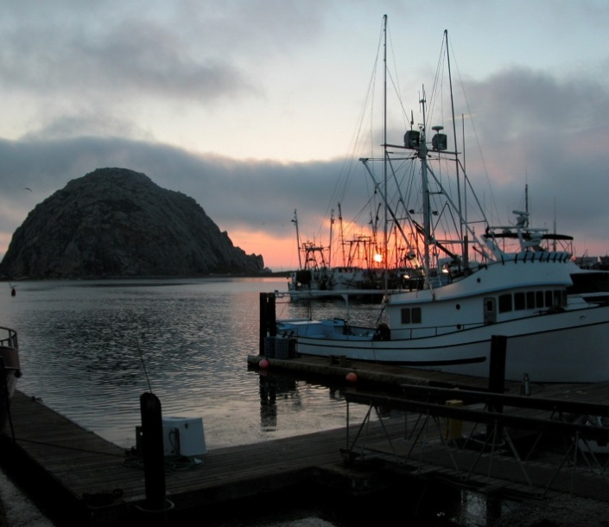
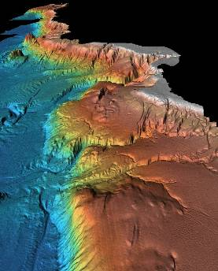
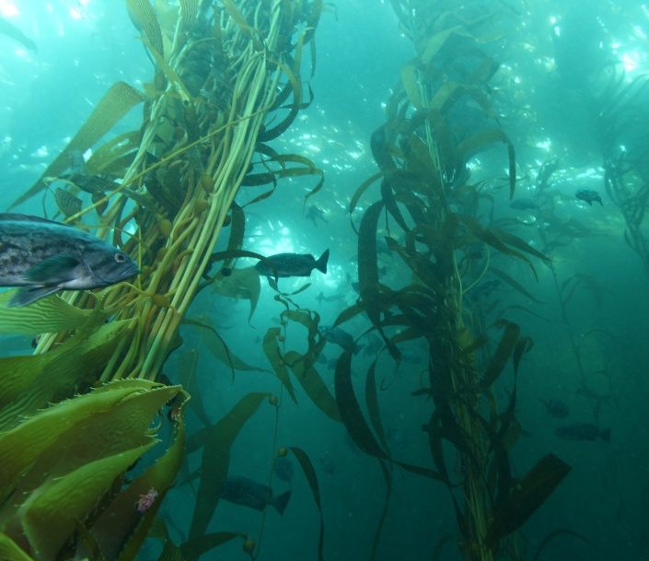
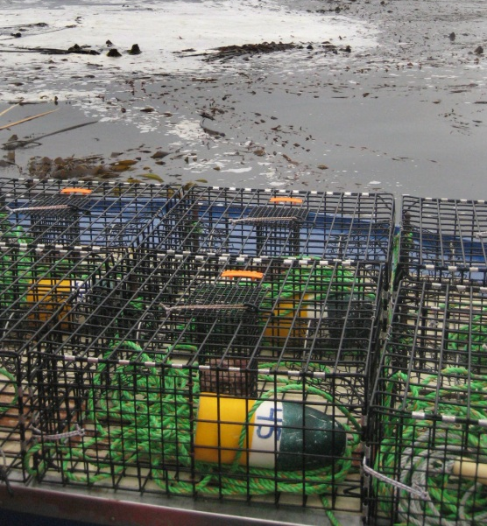
Realizing the value of the network
Putting MPA monitoring to work for California
Climate change
Resource management (e.g., fisheries)
Mobilizing a rapid response network for e.g., oil spills, harmful algal blooms, marine disease

